Slide 1
SUMMARIZATION
A N D S A V I N G H E A L T H C A R E
Jasmine Meyer, Northwestern University BA and BM

Slide 2
01
02
03
TRENDS
MOVING FORWARD
DEMO
Past, present, future, and opportunities therein
Key areas for resource investment
Prototype app with key technologies

Slide 3
INTRO
Summarization and AI: what’s the deal?

Slide 4
TRENDS
01
Contemporary patterns in summarization tools

Slide 5
TRENDS FOR THE
NEW AI AGE
3 main foci:
Medical academia
Importance of immediacy
LLMs for casual medical inquiries
** The importance of other trends should not be understated, but reviewed with appropriate attention at another time.

Slide 6
LARGE LANGUAGE MODELS AND EDUCATION
NOW
FUTURE?
Stigma from educators/administration, widespread and unregulated use from students
Embracing and standardizing their use can lead to clear benefits for healthcare as a whole

Slide 7
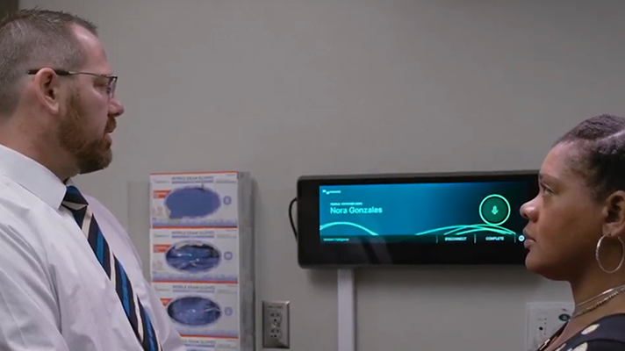
AMBIENT CLINICAL TECHNOLOGY:
the biggest current trend in medical innovation
image source: Healthcare IT News

Slide 8

HIMSS 2024 Conference
Microsoft’s Nuance Communications, Abridge and Suki, among many pursuers

Slide 9
18 billion
estimated in annual savings

Slide 10
AT-HOME DIAGNOSIS:
Technology in the wake of COVID-19

Slide 11
THE RISE OF TECHNOLOGY-SUPPORTED “SELF-DIAGNOSIS”
CHAT-GPT
SOCIAL MEDIA
SEARCH ENGINES
Casual medical inquiries in a parasocial relationship
Misinformation quickly spread, incorrect perceptions of mental health
Search results provide hints, users assume the worst sans expertise

Slide 12

MOVING FORWARD
Possible investments and strategies

Slide 13
Dangers of AI-Augmented Summarization/Access to Data
Now
After
Later
AI is omnipresent in medical tech
AI in medicine in infancy
Data theft and cyber crime

Slide 14
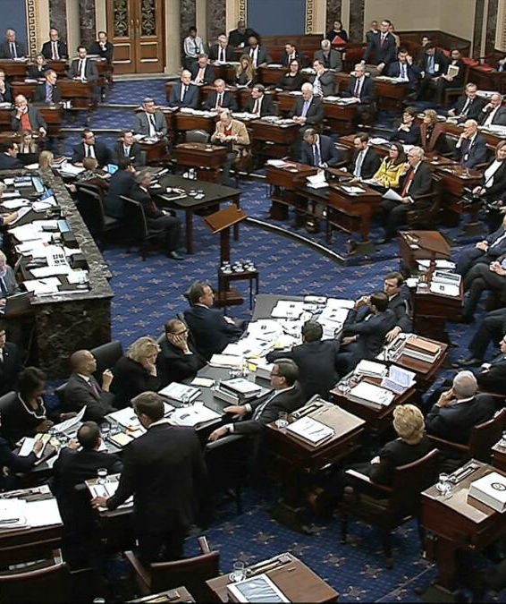
Legislative Involvement
Universalize Cotiviti healthcare technologies, maximize user base, quality of life, & profit
photo credit: Los Angeles Times

Slide 15
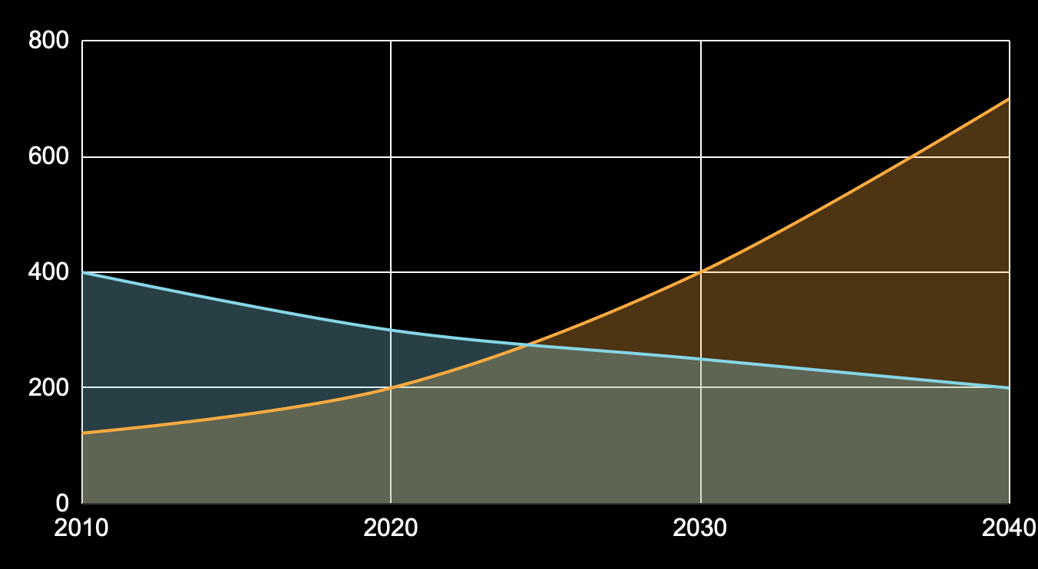
BABY RE-BOOM?
Avg. Age
Medical Workforce
Already overtaxed and understaffed medical providers vs. the population’s rising average age

Slide 16
LONG TERM VS SHORT TERM RESULTS
LLMs and AI are already revolutionizing patient care on-site
But what about off-site?
Alleviating the labor shortage, improving quality of care, and making healthcare less costly
Data security and hardware modernization/standardization will pay off in the future, but what will help the PRESENT?

Slide 17

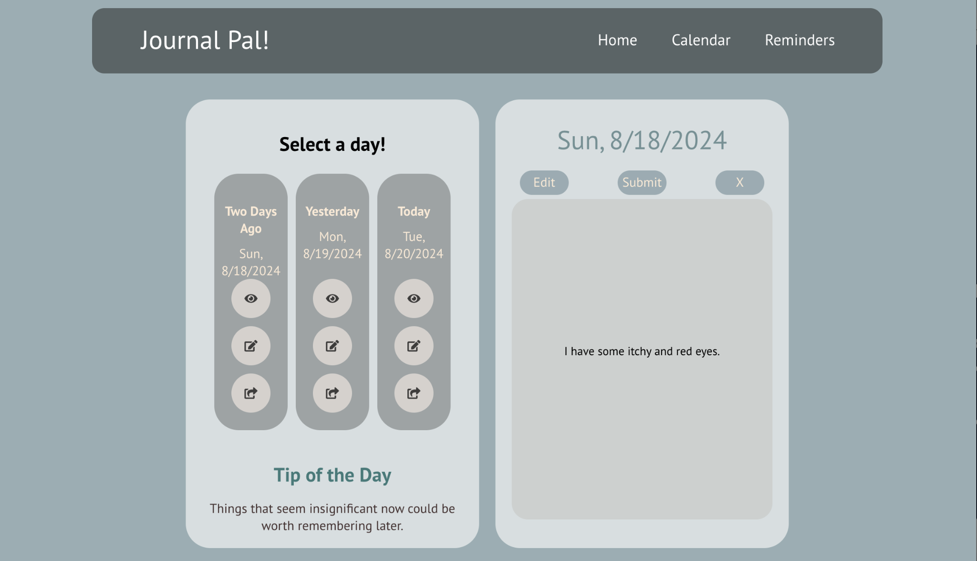
BASIC PROOF OF CONCEPT
AI-powered virtual assistant designed to make sophisticated record-keeping and analysis easy and keep provider workloads down

Slide 18
“The primary concern for [medical provider] burnout is not being able to emotionally take care of each patient individually or uniquely."
—Derick S., Respiratory Therapist, Nevada

Slide 19
THANKS!
Do you have any questions?
jasminemeyer2025@u.northwestern.edu
+1 908-635-9882
https://github.com/jasmey/cotiviti_webapp

